Slide 1
IMAGE ORGANIZER APPLICATION
Under the Guidance of
Dr. Durgansh Sharma
Nidhish Bisht (R178218023)
Samraj Singh Solanki (R178218033)

Slide 2
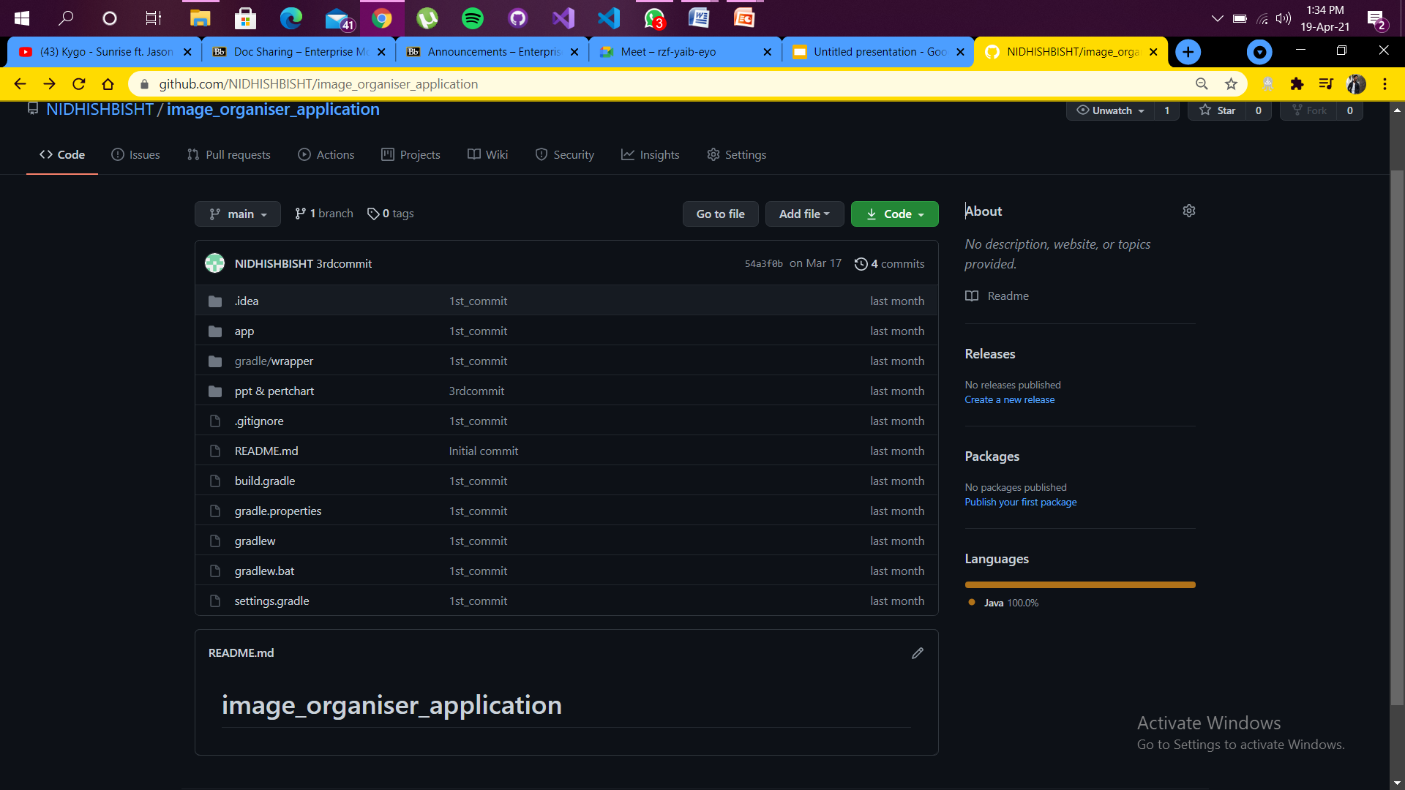
Github link:- https://github.com/NIDHISHBISHT/image_organiser_application

Slide 3
SDLC MODEL(Agile Model)
Agile SDLC model is a combination of iterative and incremental process models with focus on process adaptability and customer satisfaction by rapid delivery of working software product. Agile Methods break the product into small incremental builds.
Agile is based on the adaptive software development methods, whereas the traditional SDLC models like the waterfall model is based on a predictive approach. Predictive teams in the traditional SDLC models usually work with detailed planning and have a complete forecast of the exact tasks and features to be delivered in the next few months or during the product life cycle.

Slide 4
SCRUM MODEL
Phases of Scrum Model
Product Backlog Creation
Sprint Planning and Sprint Backlog Creation
Working on the Sprint Daily Scrum Meetings
Product Increment and Sprint Review
Retrospective and Next Sprint Planning

Slide 5
PROJECT OVERVIEW
Make an Android Application Using Python Model which can
differentiate between Documents, Natural images and Family
photos so that we can delete unnecessary images and free up the device storage.

Slide 6
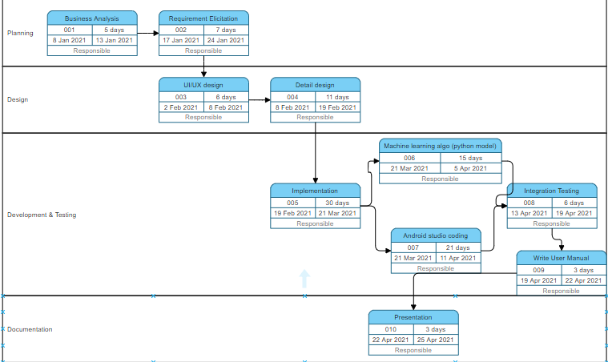
PERT CHART

Slide 7
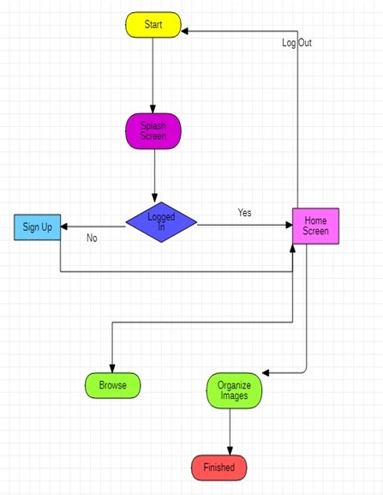
WORKFLOW

Slide 8
ADAPTERS
HTTP ADAPTERS:- 1.The HTTP adapter sends an HTTP or HTTPS request to a URL and processes t the response to return the web page in JSON format.
2.This adapter does not support multiple configuration nodes.
3.The HTTP adapter now also supports multipart file upload.
SQL ADAPTERS:- The SqlDataAdapter Object and DataSet objects are combine to perform b both data access and data manipulation operations in the SQL Server

Slide 9
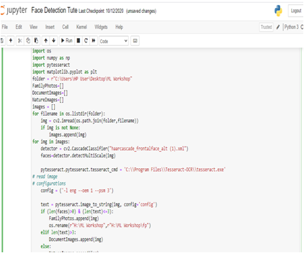
PROGRESS WHILE WORKING ON ADAPTERS
Till now we have been working on the machine learning algorithm. In the snippet attached alongside you’ll find the execution of the algorithm in jupyter notebook.

Slide 10
DATABASE DESIGN
SQLite Database
SQLite is an in-process library that implements a self-contained, serverless, zero-configuration, transactional SQL database engine. It is a database, which is zero-configured, which means like other databases you do not need to configure it in your system.SQLite engine is not a standalone process like other databases, you can link it statically or dynamically as per your requirement with your application. SQLite accesses its storage files directly.
Firebase Database
Firebase is a Backend-as-a-Service (Baas). It provides developers with a variety of tools and services to help them develop quality apps, grow their user base, and earn profit. It is built on Google’s infrastructure.Firebase is categorized as a NoSQL database program, which stores data in JSON-like documents.

Slide 11
Data to be stored in the Databases
User name
First Name
Last Name
Password
Email id
Phone number

Slide 12
SQLITE DATABASE
FIREBASE DATABASE
UserName | First name | Last Name | Password | Email Id | Phone No.
nidhish | nidhish | bisht | 123 | bishtnidhish10@gmail.com | 9761206833
samraj | samraj | singh | 456 | samraj@gmail.com | 9617417193
USERNAME | Phone Number
nidhish | 9761206833
samraj | 9617417193

Slide 13
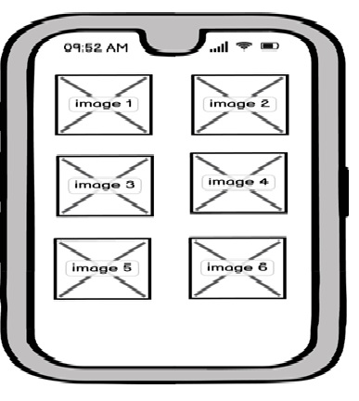
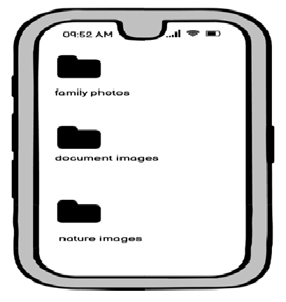
WIREFRAME

Slide 14
OPERATIONAL ANALYTICS

Slide 15
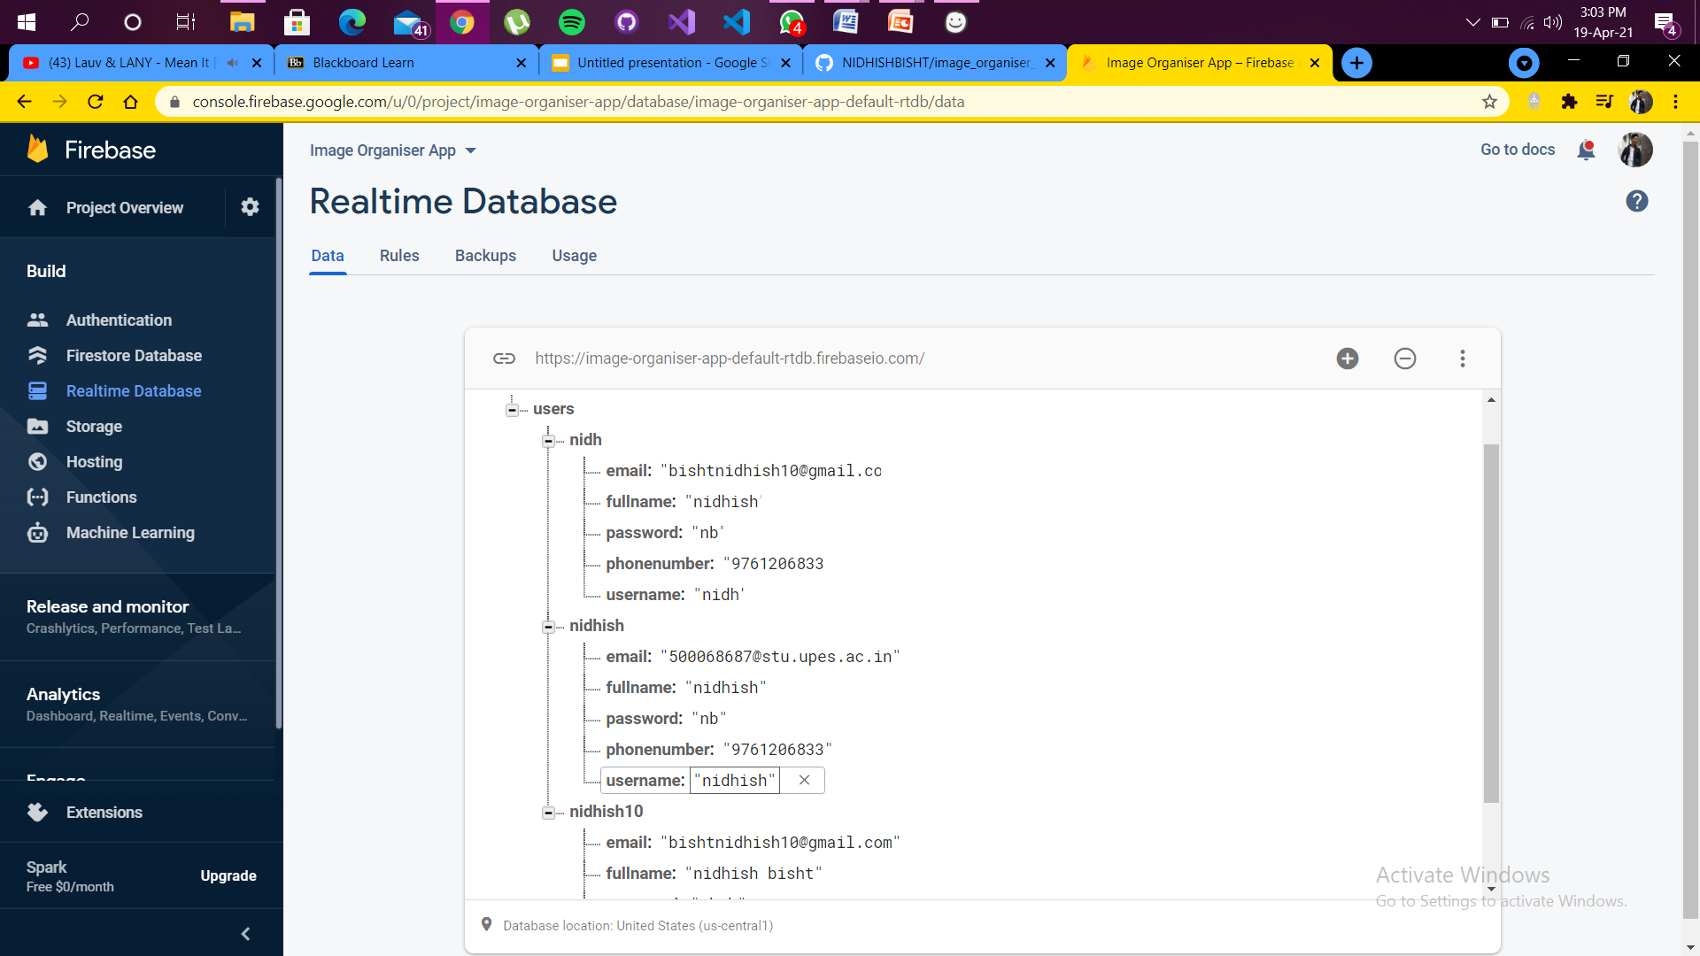
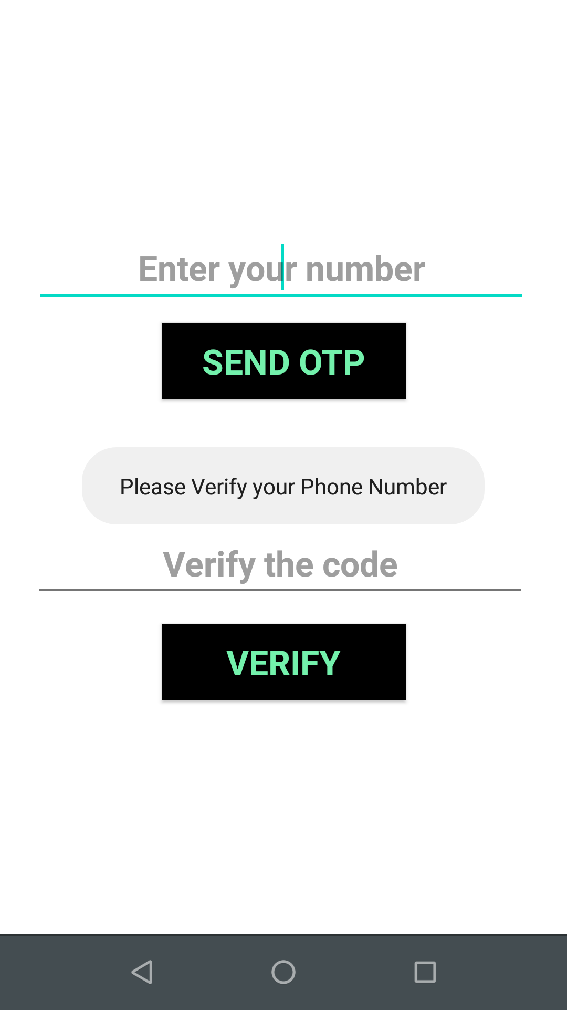
AUTHENTICATION
USER VERIFICATION (VIA PASSWORD)
OTP AUTHENTICATION

Slide 16
JSON FILE
What is Json?
JSON: JavaScript Object Notation.
JSON is a syntax for storing and exchanging data.
JSON is text, written with JavaScript object notation.
JSON (JavaScript Object Notation) is a lightweight data-interchange format. It is easy for humans to read and write. It is easy for machines to parse and generate. It is based on a subset of the JavaScript Programming Language Standard ECMA-262 3rd Edition - December 1999. JSON is a text format that is completely language independent but uses conventions that are familiar to programmers of the C-family of languages, including C, C++, C#, Java, JavaScript, Perl, Python, and many others. These properties make JSON an ideal data-interchange language.

Slide 17
{ CODE SNIPPET(JSON) }
String url="http://192.168.220.120:5111/sp";
filename1[x]=imagefile.getName();
x++;
StringRequest stringRequest = new StringRequest(Request.Method.POST, url, new Response.Listener<String>() {
@Override
public void onResponse(String response){
z++;
Toast.makeText(s1,"Image "+response.substring(1)+" Accessed.",Toast.LENGTH_LONG).show();
if(response.substring(0,1).equals("0")) {
File j = new File(spath + "/FamilyPhotos/"+ filename1[y]);
boolean t=imagefile.renameTo(j);
y++;
}
if(response.substring(0,1).equals("1")) {
File j = new File(spath + "/DocumentImages/" +
}
})

Slide 18
ADMIN PANEL
android.app.admin
Kotlin |Java
Provides device administration features at the system level, allowing you to create security-aware applications that are useful in enterprise settings, in which IT professionals require rich control over employee devices.

Slide 19
ADMIN PANEL CLASSES
ConnectEvent A class that represents a TCP connect event initiated through the standard network stack.
DelegatedAdminReceiver Base class for delegated apps to handle callbacks related to their delegated capabilities.
DeviceAdminInfo This class is used to specify meta information of a device administrator component.
DeviceAdminReceiver Base class for implementing a device administration component.
DeviceAdminService Base class for a service that device owner/profile owners can optionally have.
DevicePolicyManager Public interface for managing policies enforced on a device.

Slide 20
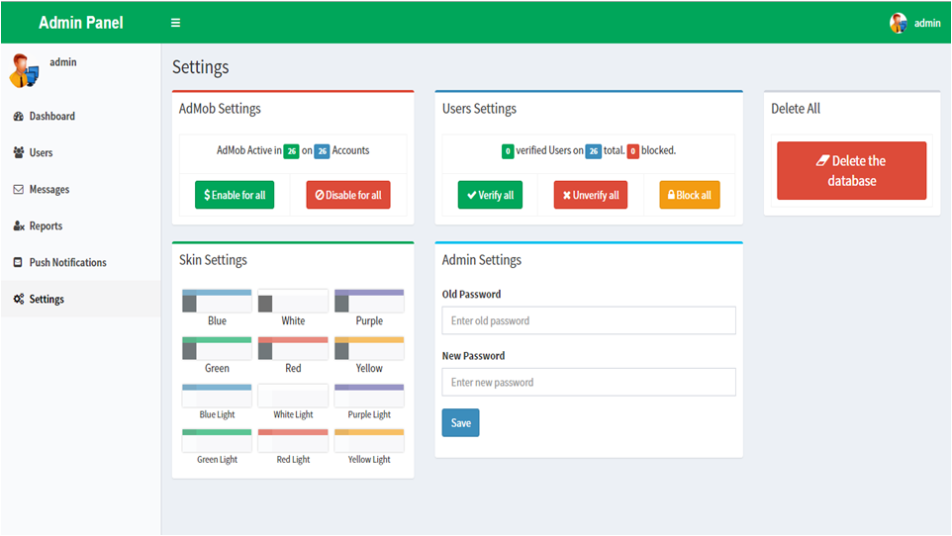

Slide 21
THANK YOU

